Slide 1

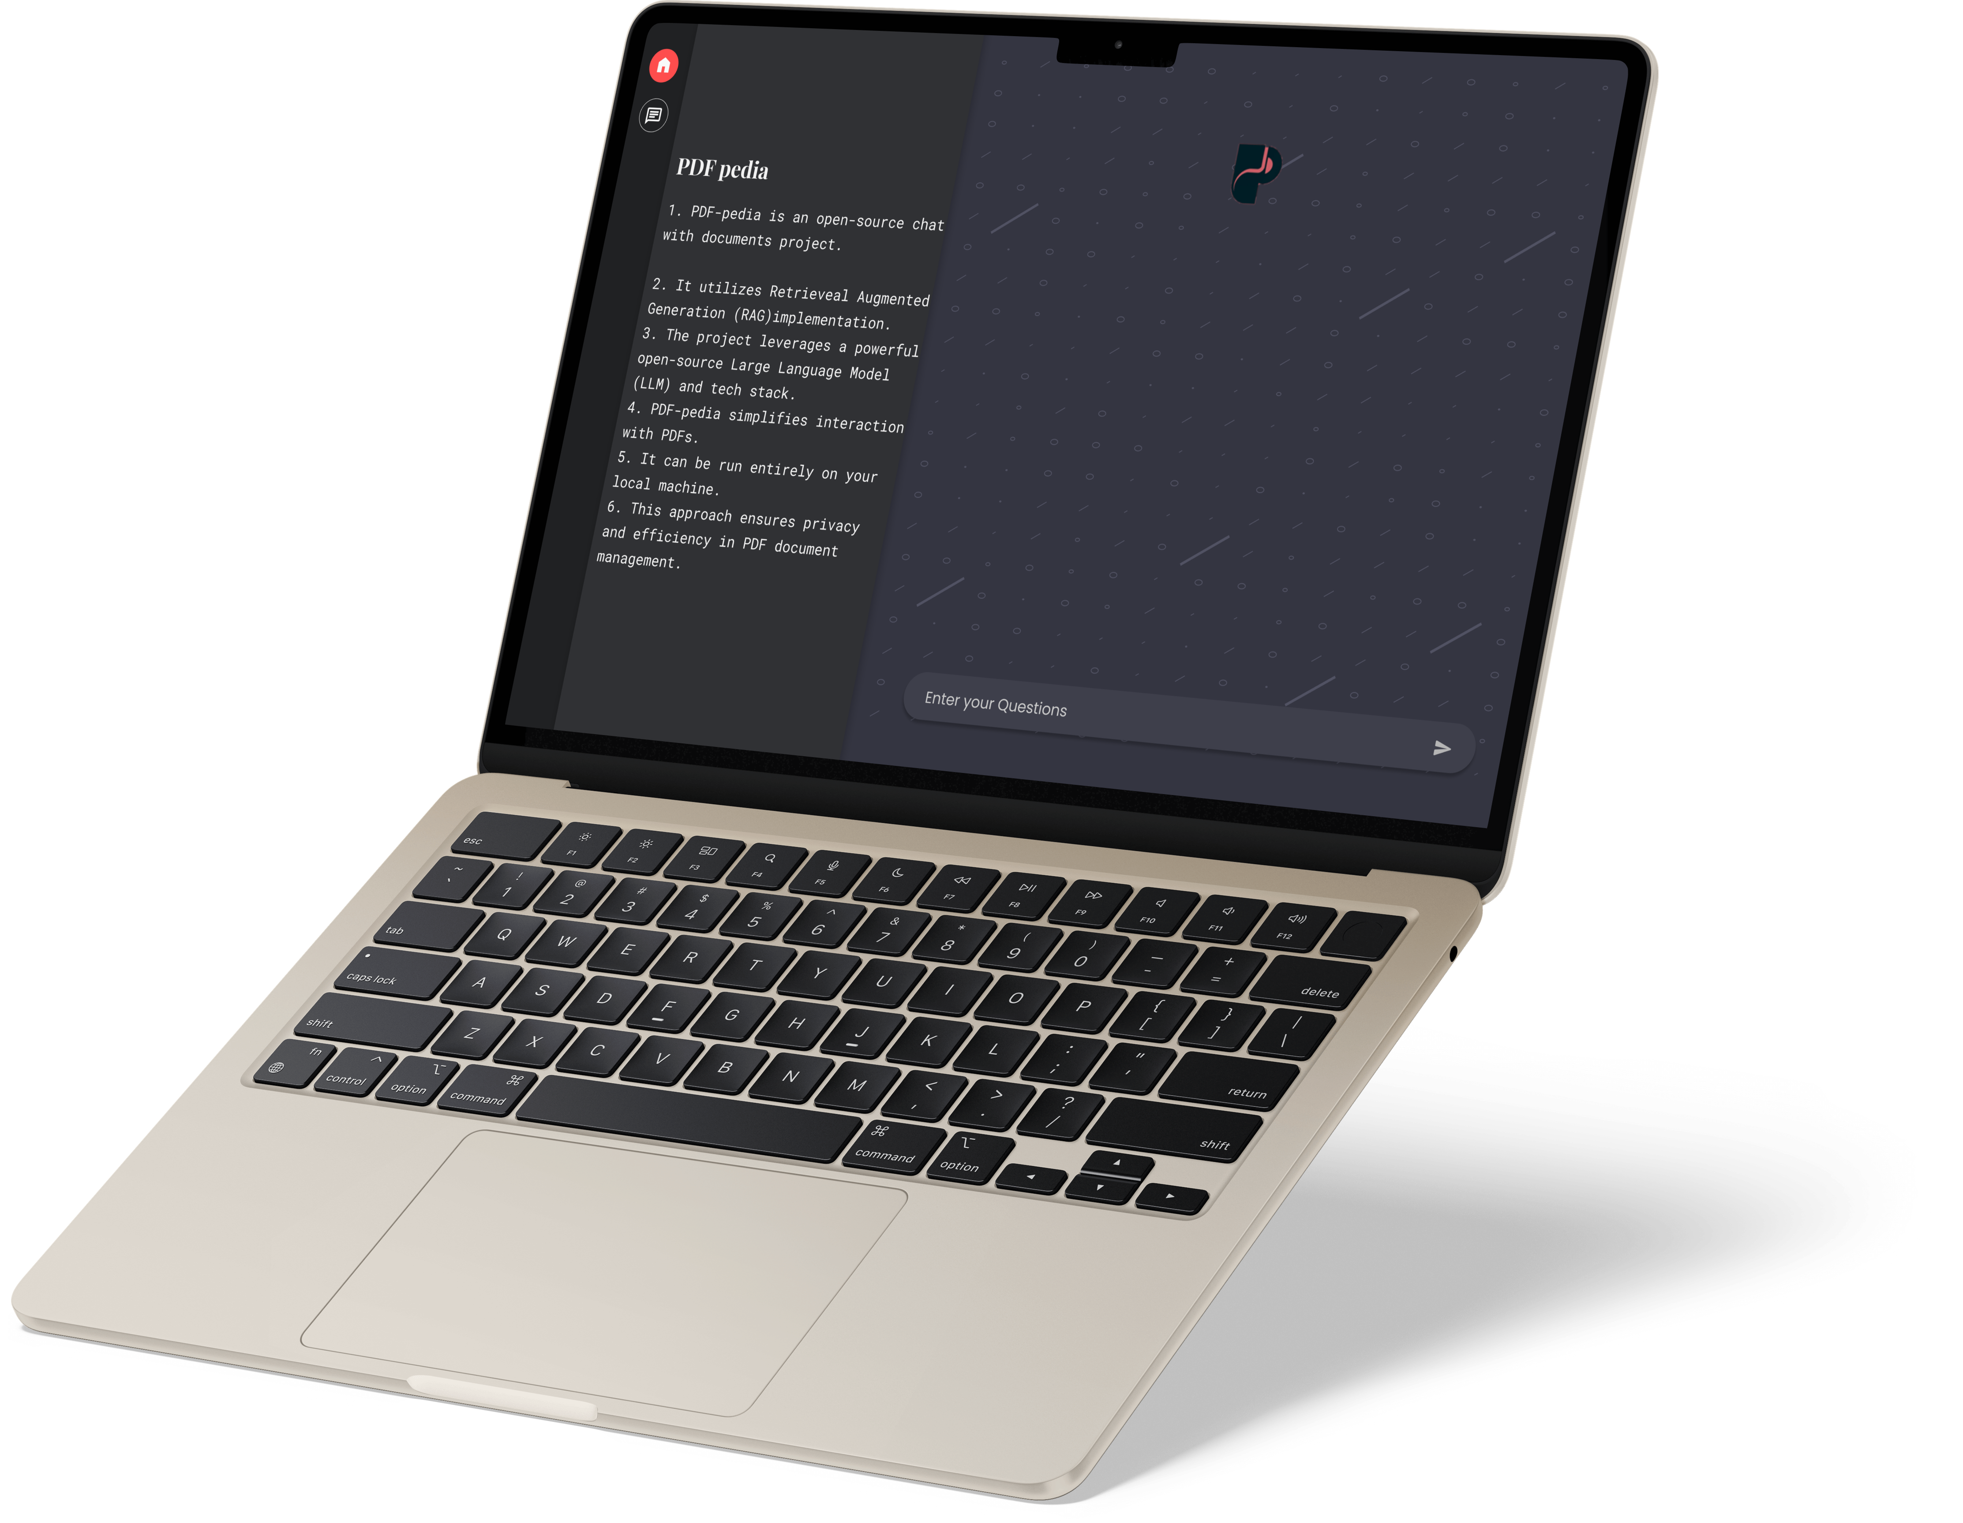
Tired of scrolling
Docs?

Slide 2

Introducing PDFpedia
What is PDFpedia?
Key Features of PDFpedia
Tech Stack of PDFpedia
Significance and Excitement of PDFpedia
Questions & Discussion
Your document companion

Slide 3
Agenda
What is PDFpedia?
What is PDFpedia?
Key Features of PDFpedia
Tech Stack of PDFpedia
Significance and Excitement of PDFpedia
Questions & Discussion
PDFpedia is a chat with documents project that simplifies the way you interact with PDFs.
It uses Retrieveal Augemented Generation(RAG) implementaion that leverages a powerful open-source Large language model and tech stack to provide a user-friendly application.
Objective:
Simplifying the process of Research, learning.
Simplify Your PDF Interactions: PDF-pedia is more than just a project; it's a chat with documents. It's designed to simplify and enhance the way you interact with PDFs
To ensure privacy and security by running entirely on your local machine.

Slide 4
What is PDFpedia?
PDFpedia is a chat with documents project that simplifies the way you interact with PDFs.
It uses Retrieveal Augemented Generation(RAG) implementaion that leverages a powerful open-source Large language model and tech stack to provide a user-friendly application.
Objective:
Simplifying the process of Research, learning.
Simplify Your PDF Interactions: PDF-pedia is more than just a project; it's a chat with documents. It's designed to simplify and enhance the way you interact with PDFs
To ensure privacy and security by running entirely on your local machine.

Slide 5



Key Features of PDFpedia
1
2
3
Simplified PDF interaction: PDFpedia simplifies the way you interact with PDF documents, making it easier to manage and access information.
Open-source nature: PDFpedia is an open-source project, allowing for transparency and community contributions.
Local execution: PDFpedia can run entirely on your local machine, ensuring privacy and efficiency.

Slide 6
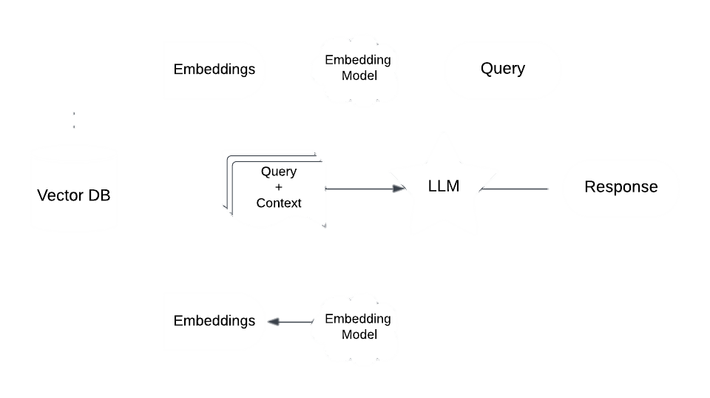
Workflow
The workflow of PDFpedia will be as follows
Receive query from the user.
Convert it to an embedded query vector preserving the semantics, using an embedding model.
Retrieve the top-k relevant content from the vector database by computing similarity between the query embedding and the content embedding in the database.
Pass the retrieved content and query as a prompt to an LLM.
The LLM gives the required response.
Fetch Relevant Context

Slide 7



Tech Stack of PDFpedia
Technologies
Roles and Benefits
Voy 🕸️🦀
Ollama
LangChain.js 🦜️🔗
Transformers.js
Next.js
Voy: storing and managing vectors
Ollama: responsible for running a Language Model Locally
LangChain.js: backbone of our application used, framework for making applications using llms
Transformers.js: Running embeddings in the browser.
Next.js: Building Full-Stack Applications

Slide 8

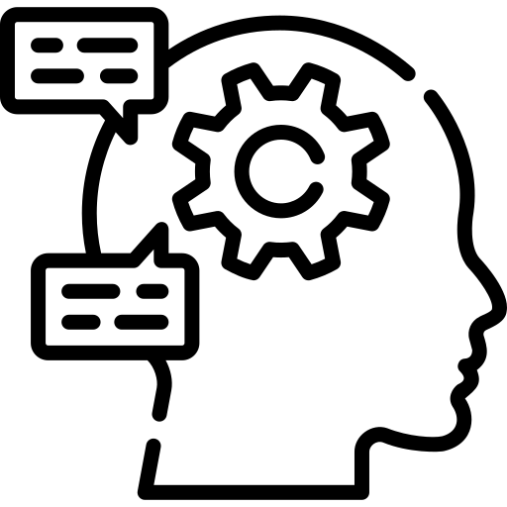

Significance and Excitement of PDFpedia
Ease of Access
Open-Source Nature
Privacy-Focused and Efficient Solution
PDFpedia simplifies the way users interact with PDFs, making it more user-friendly and efficient.
PDFpedia is an open-source project, allowing users to access and contribute to its development.
PDFpedia can run entirely on the user's local machine, ensuring privacy and providing an efficient PDF document management solution.

Slide 9
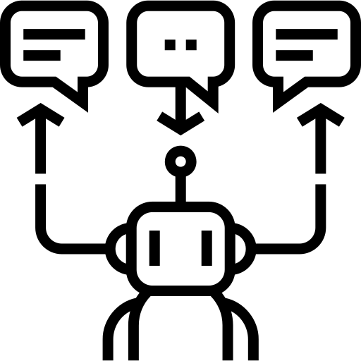
Overview
PDFpedia is a user-friendly solution that combines the power of open-source LLMs with local execution.
PDFpedia supports multiple languages and can be easily integrated into existing workflows.
It allows you to have natural conversations with your PDF documents, making it easier to extract information, generate answers, and more.

Slide 10
Future Features
Multi-File Type Support
Text-to-Speech Conversion
OCR (Optical Character Recognition):
Users can interact with and manage different types of documents within the application including DOCX, XLSX, PPTX, TXT, and more.
Implement a text-to-speech feature that can read the content of PDF documents aloud. This can assist users who prefer auditory information or have visual impairments.
Implement OCR technology to extract text from scanned documents or images within PDFs.
Cloud Integration
Advanced Search
Multi-Language Support
Provide the option to sync and store PDF documents in the cloud, allowing users to access their documents from any device.
Enhance the search functionality to support advanced queries, including filters, to help users find specific information within PDFs more efficiently.
Expand language support for natural language interactions and document content recognition to serve a global user base.

Slide 11


Questions & Discussion
Q1: What problem does PDF-pedia solve, and why is it relevant in today's market?
Ans: PDF-pedia addresses the challenge of efficient PDF document management. It simplifies how users interact with PDFs, making it easier to extract information and generate answers. This is relevant in a world where PDFs are a common format for information exchange, but tools for seamless interaction are limited.
Q2: How is PDF-pedia different from existing PDF management solutions?
Ans: PDF-pedia stands out because it leverages open-source Large Language Models, runs entirely locally for privacy, and provides a natural language interface for document interaction. This makes it a powerful and unique tool in the PDF management space.
Q3: Is my data secure when using PDF-pedia?
Ans: Absolutely. PDF-pedia runs entirely locally, ensuring that your data remains private and secure on your own machine.

Slide 12
Questions & Discussion
Q4: What file formats does PDF-pedia support for document upload?
Ans: PDF-pedia primarily supports PDF files, but we are planning to add support for other common document formats in future updates.
Q5: What is our long-term vision for PDF-pedia?
Ans: Our long-term vision is to become the go-to solution for PDF document management. We envision PDF-pedia evolving with cutting-edge technology, user-driven features, and global recognition as a trusted PDF tool.
Q6: What is the maximum file size supported for PDF uploads?
Ans: The maximum file size supported may vary based on your machine's specifications, but we aim to provide support for reasonably large PDF files. Please check system requirements for details.

Slide 13


Team Details
Mentor
Yashu Varsheney
Bhaskar Pandey
Yash Kumar singh
Aryan srivastava
Naveen Agrahari
Vinay singh Yadav
Aman Prajapati

